Slide 1
Same anchor locations for 100 times: zsh: killed(out of memory)
analysis: 861samples*8inits*8resp*100counts+errorlist861*8*2(twolists)
Same issue for 50 times

Slide 2
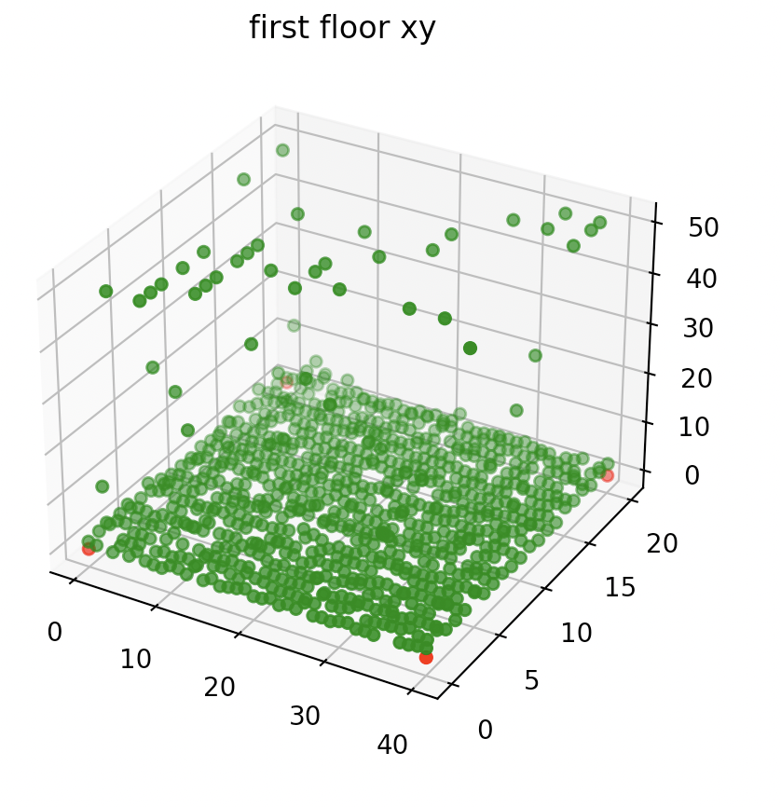
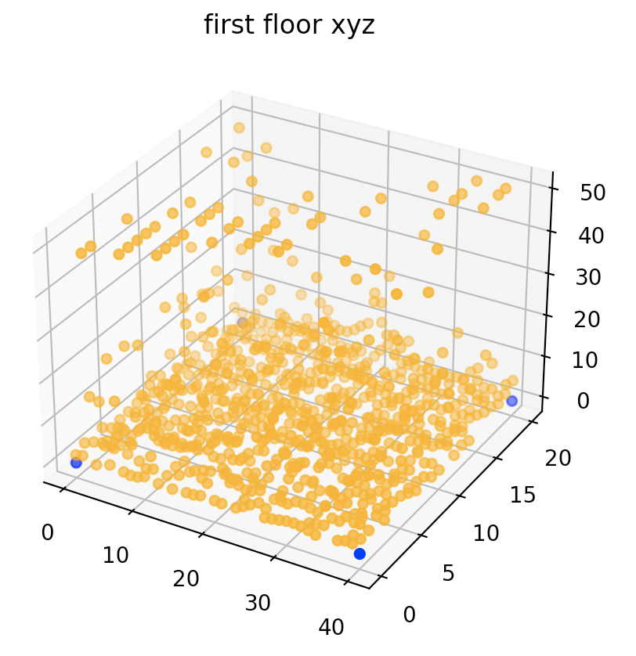
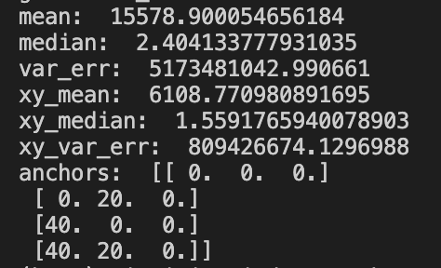
One set of anchors for 10 times, each time with one round of rotation for initiating with DoP, noise mu = 0&var = 1m
Anchors 1st floor; samples 1st floor:
Median of errors for each sample point on x,y coordinates
Median of errors for each sample point on x,y,z coordinates

Slide 3
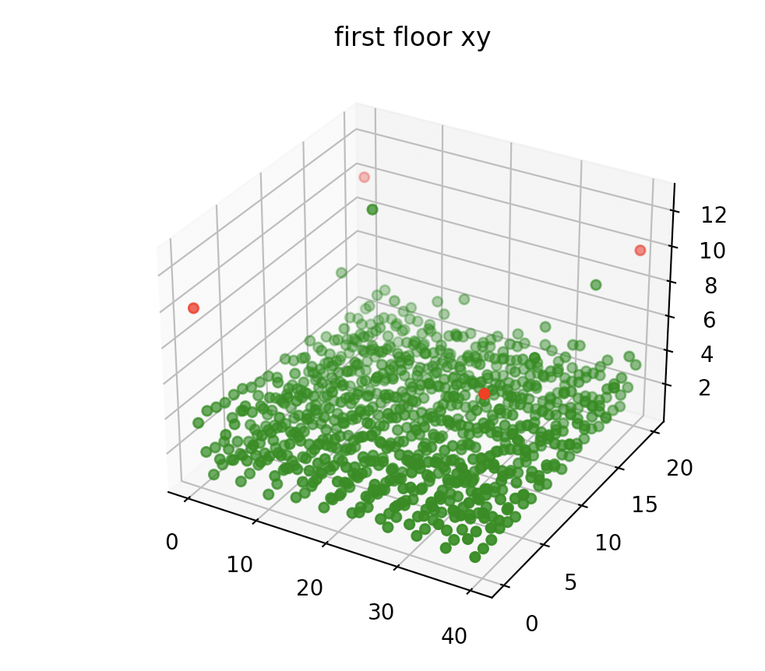
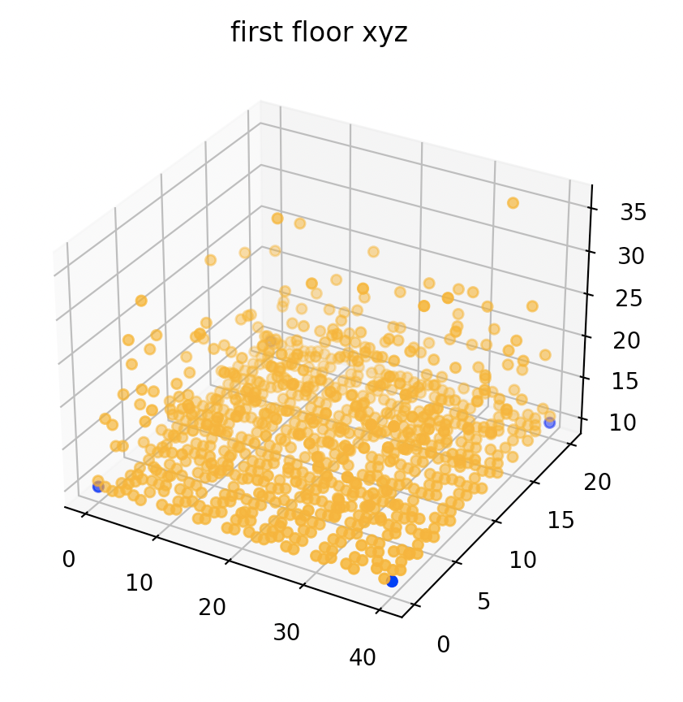
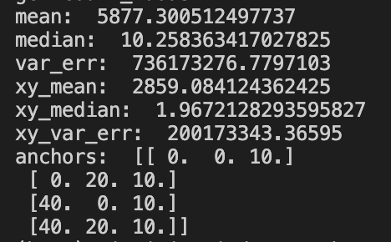
One set of anchors for 10 times, each time with one round of rotation for initiating with DoP, noise mu = 0&var = 1m
Anchors 2nd floor; samples 1st floor:
Median of errors for each sample point on x,y coordinates
Median of errors for each sample point on x,y,z coordinates

Slide 4
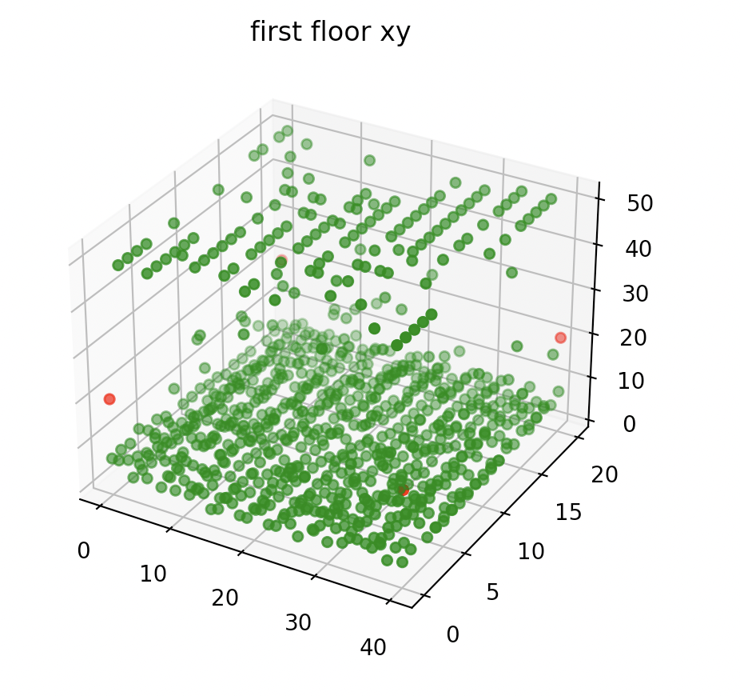
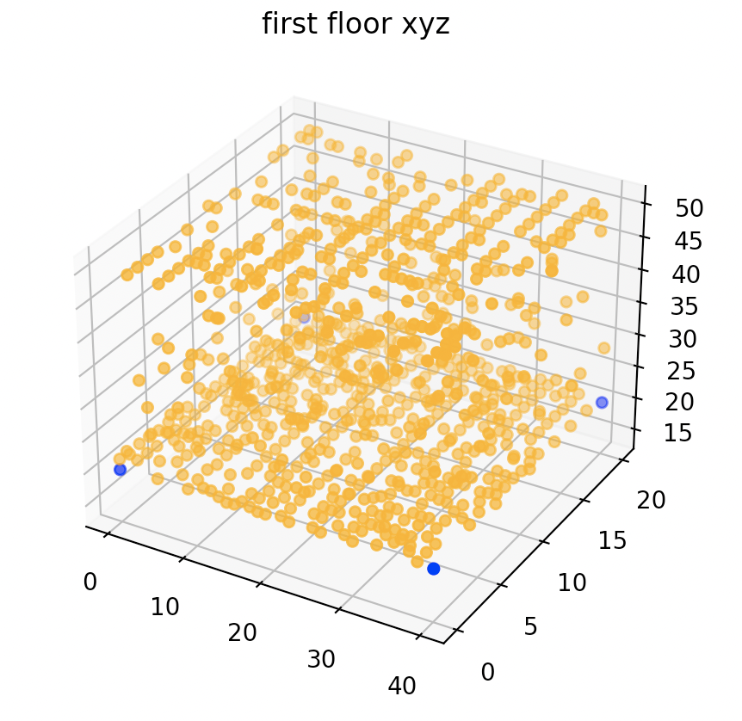
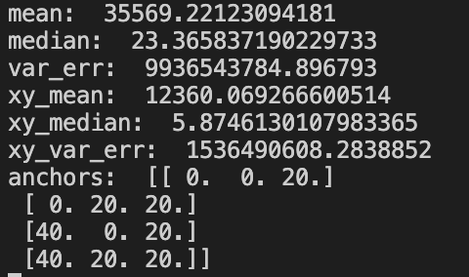
One set of anchors for 10 times, each time with one round of rotation for initiating with DoP, noise mu = 0&var = 1m
Anchors 3rd floor; samples 1st floor:
Median of errors for each sample point on x,y coordinates
Median of errors for each sample point on x,y,z coordinates

Slide 5
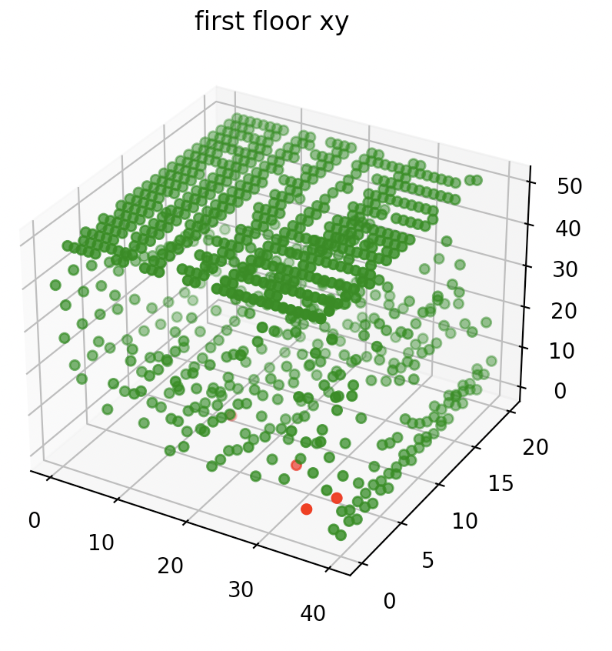
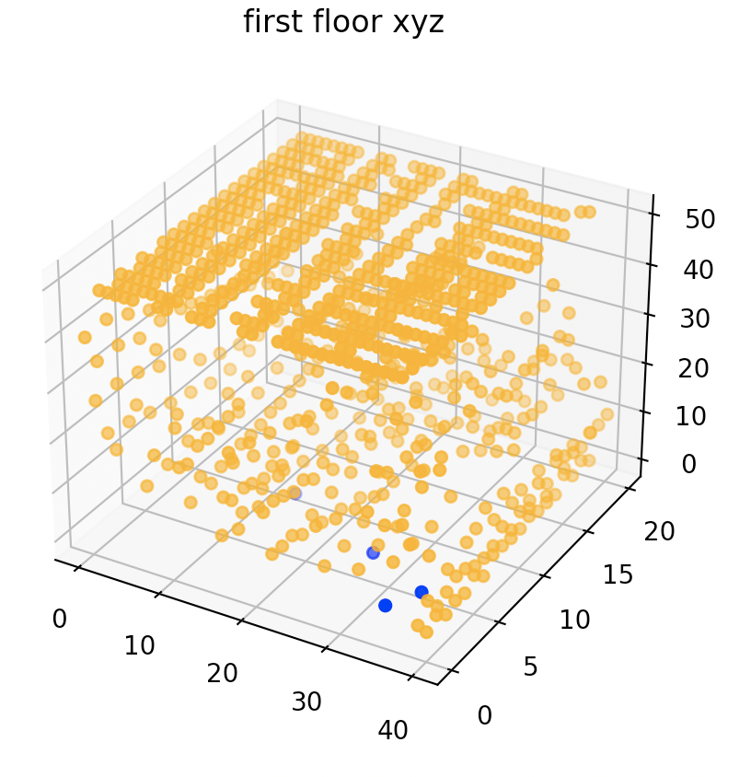
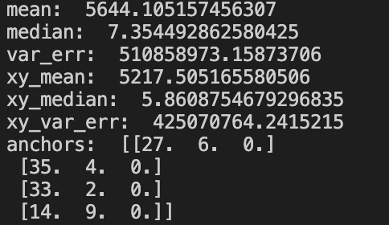
random sets of anchors for 10 times, each time with one round of rotation for initiating with DoP, noise mu = 0&var = 1m
Anchors 1st floor; samples 1st floor:
Median of errors for each sample point on x,y coordinates
Median of errors for each sample point on x,y,z coordinates

Slide 6
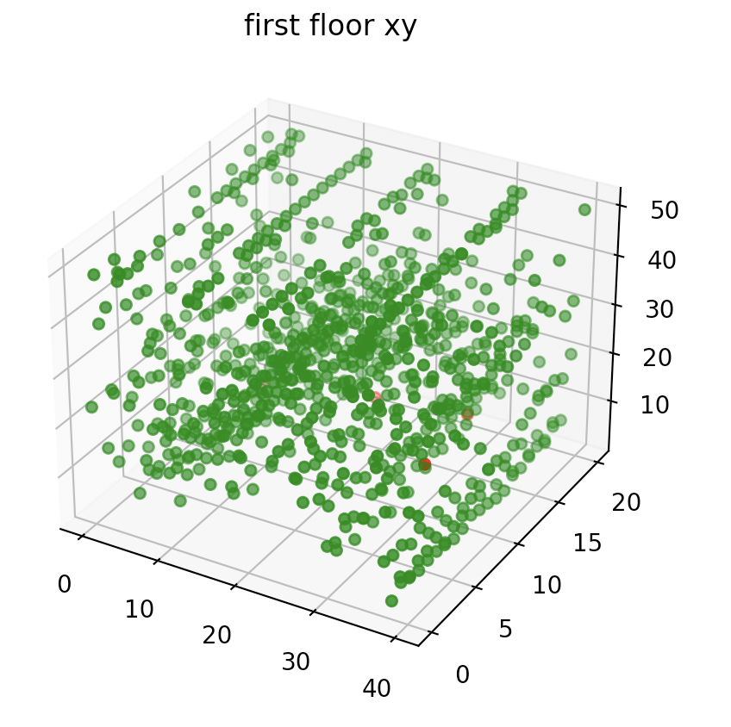
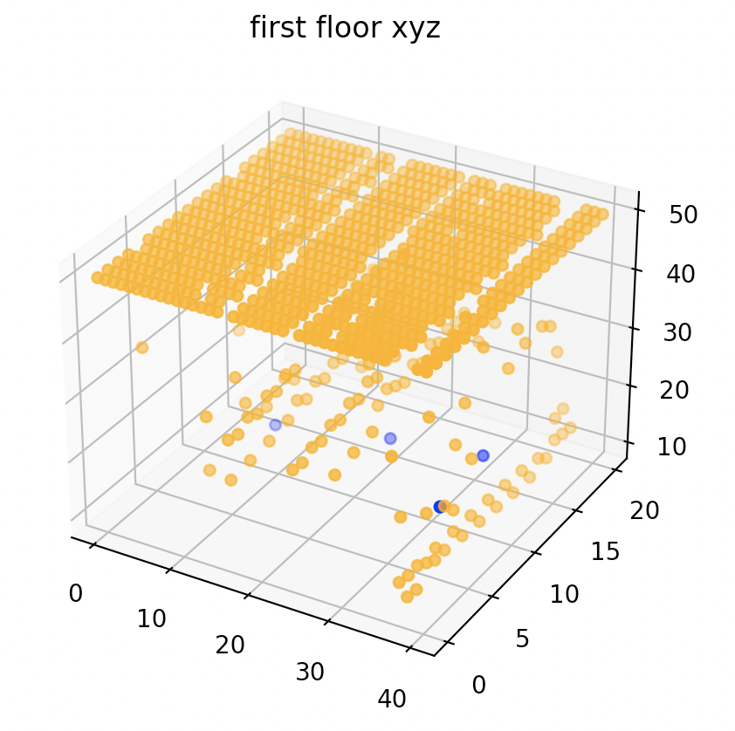
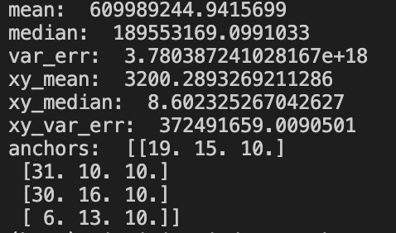
random sets of anchors for 10 times, each time with one round of rotation for initiating with DoP, noise mu = 0&var = 1m
Anchors 2nd floor; samples 1st floor:
Median of errors for each sample point on x,y coordinates
Median of errors for each sample point on x,y,z coordinates

Slide 7
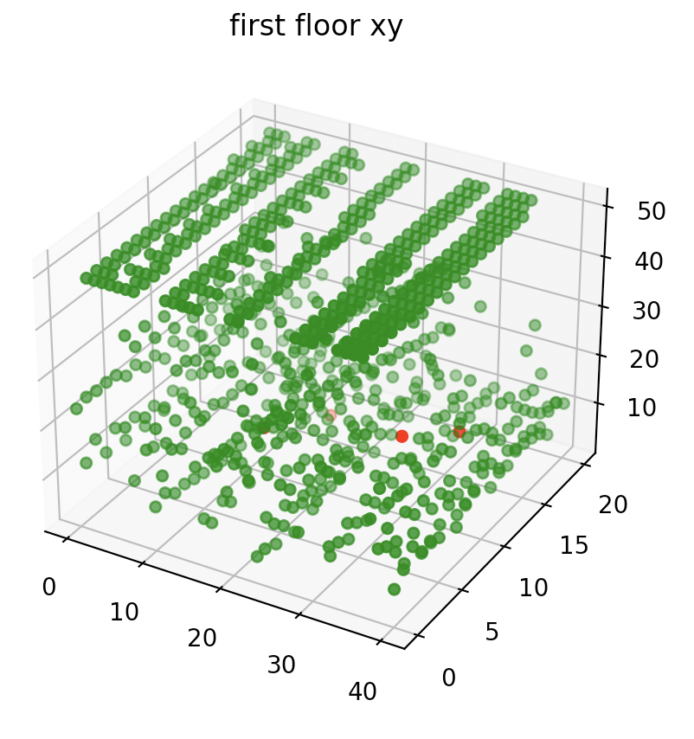
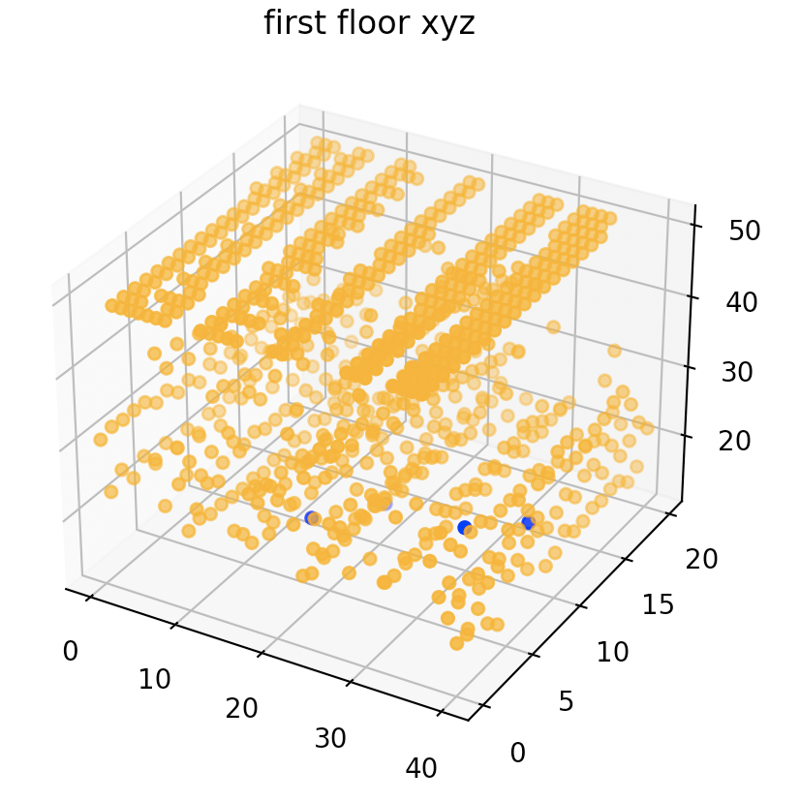
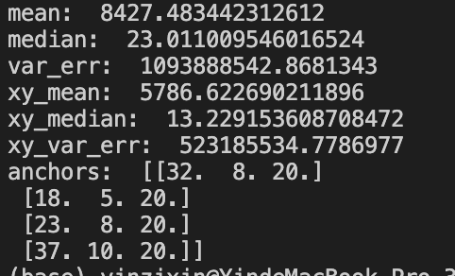
random sets of anchors for 10 times, each time with one round of rotation for initiating with DoP, noise mu = 0&var = 1m
Anchors 3rd floor; samples 1st floor:
Median of errors for each sample point on x,y coordinates
Median of errors for each sample point on x,y,z coordinates

Slide 8
Analysis: the errors caused by difference in z axis and anchor locations are mostly reflected on the z axis;
localization on x,y axis is robust to the above changes

